Slide 1


Stock trend prediction using sentiment analysis
Gropu5
Liu，Jiyuan 1129450
Xiao，Qianyi 1129695

Slide 2
Contents
1.Background introduction
2. Data processing
3. Random Forest model

Slide 3
Background introduction
Stock trend prediction has been a popular topic due to its importance in economy and risk management.

Slide 4
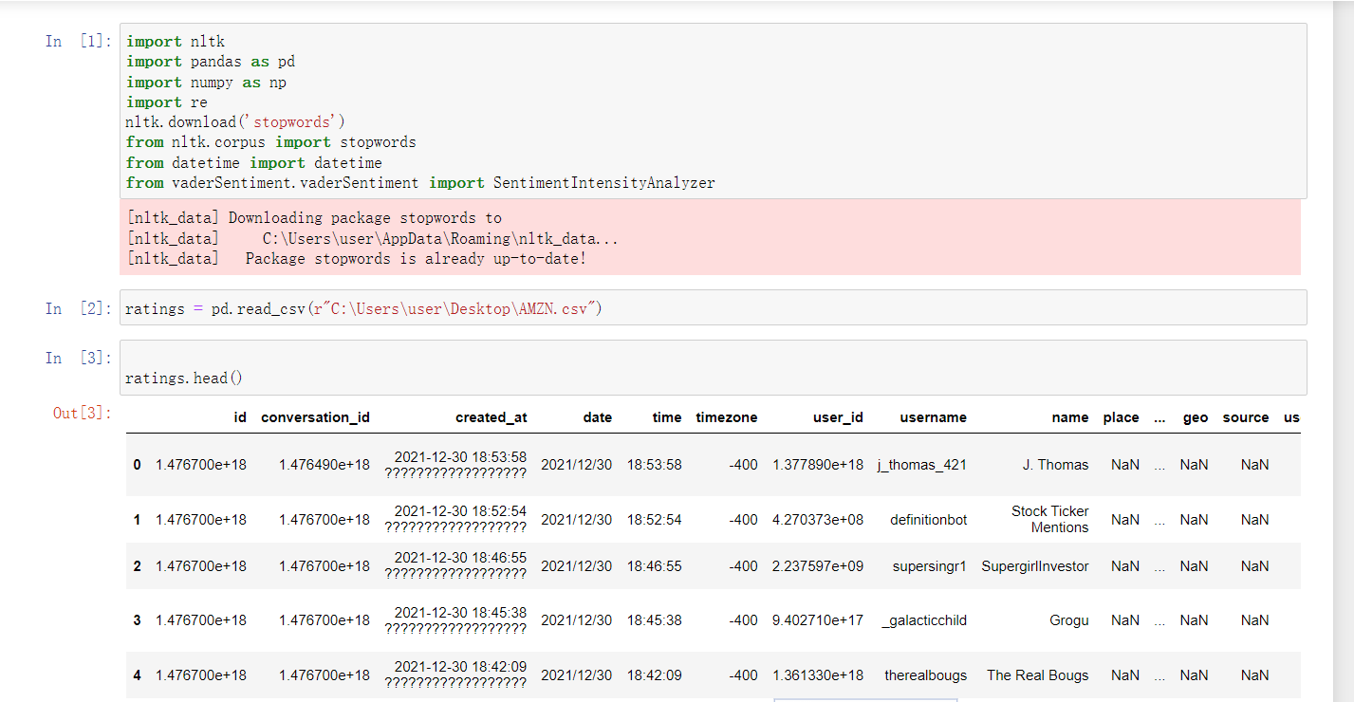
Import package&download data from Yahoo

Slide 5
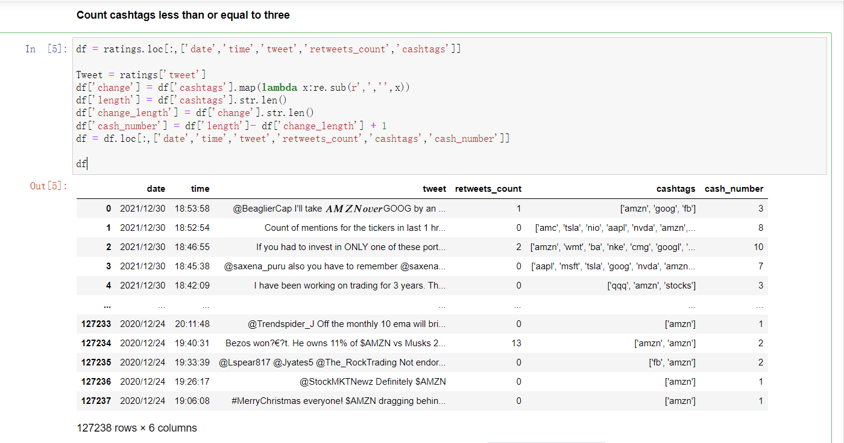
Count cash tags

Slide 6
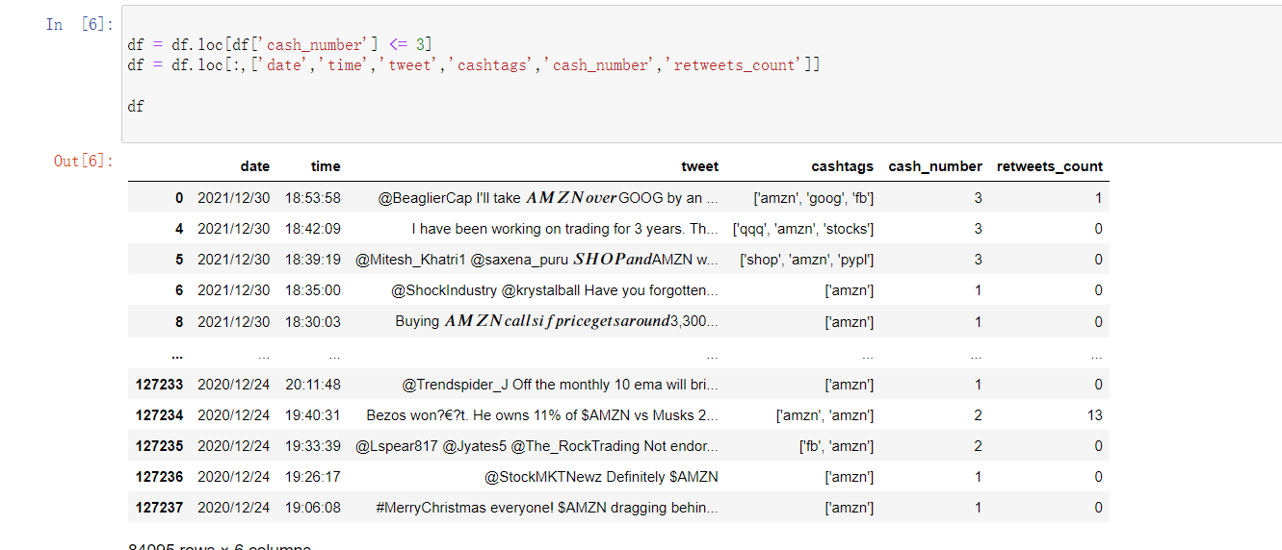
Remove cashtags less or equal to three

Slide 7
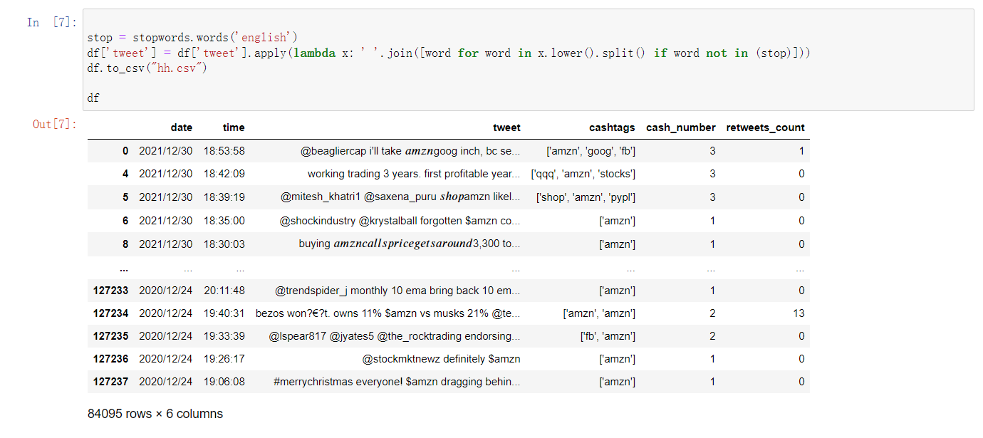
Remove stop words

Slide 8
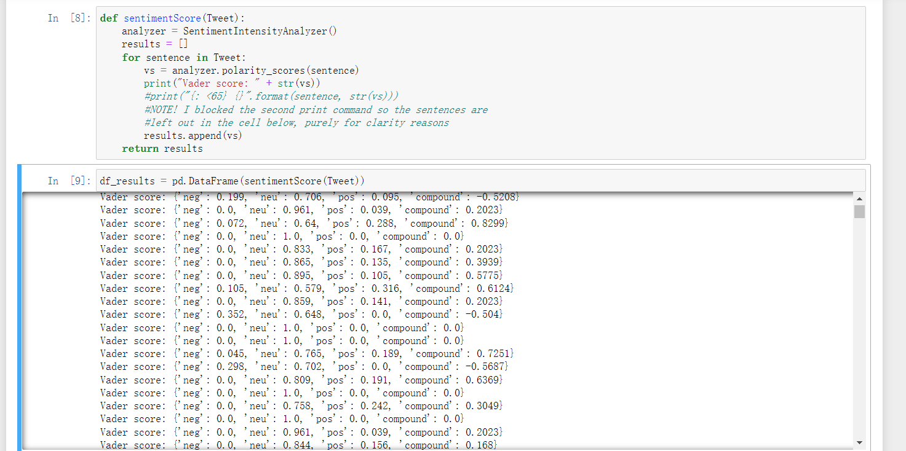
Calculate sentiment score

Slide 9
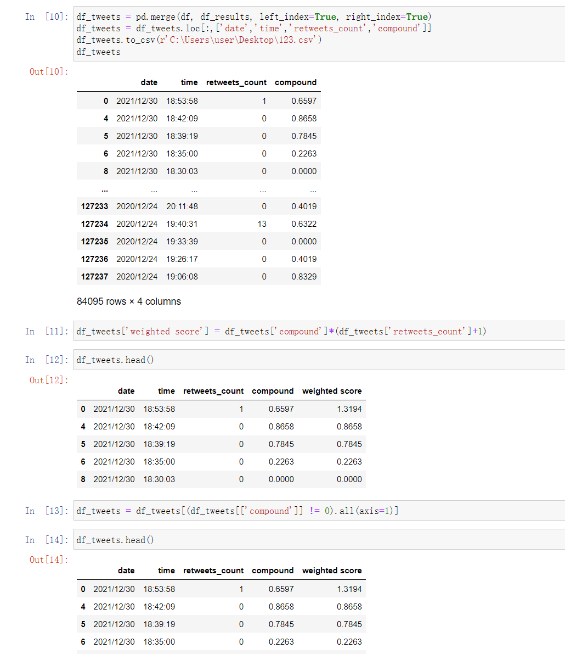
Calculate weighted score

Slide 10
Calculate weighted score

Slide 11
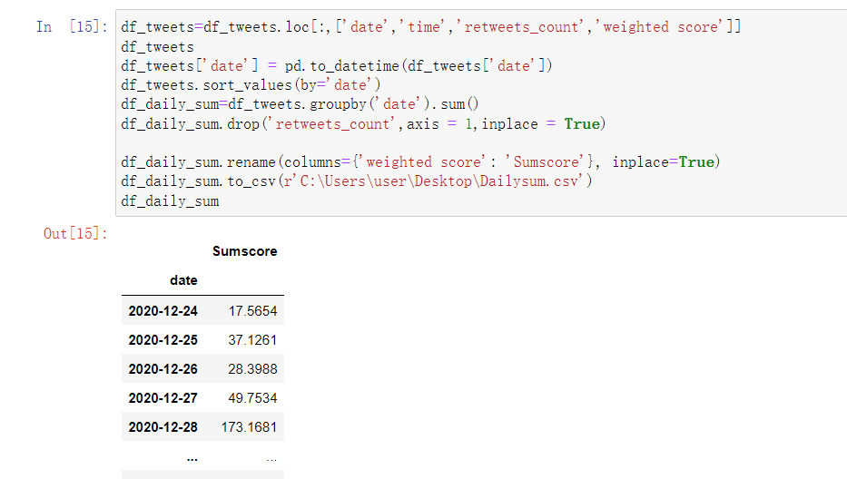
Final Sum score

Slide 12
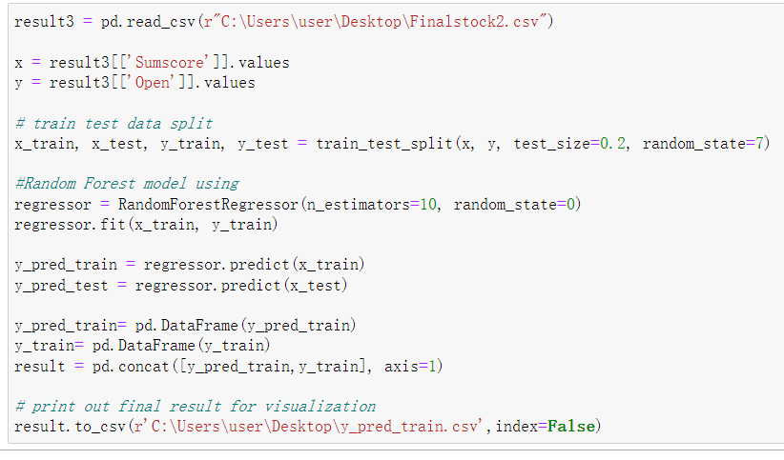
Random Forest

Slide 13
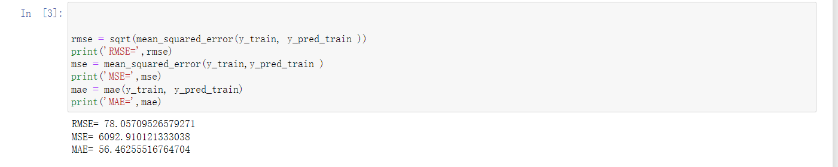
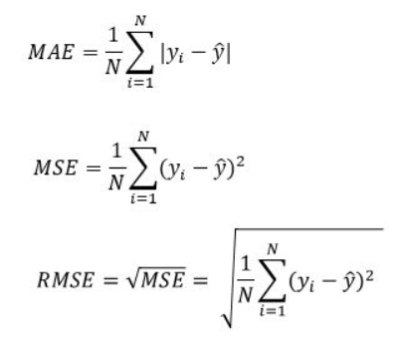
Calculate RMSE MSE MAE

Slide 14
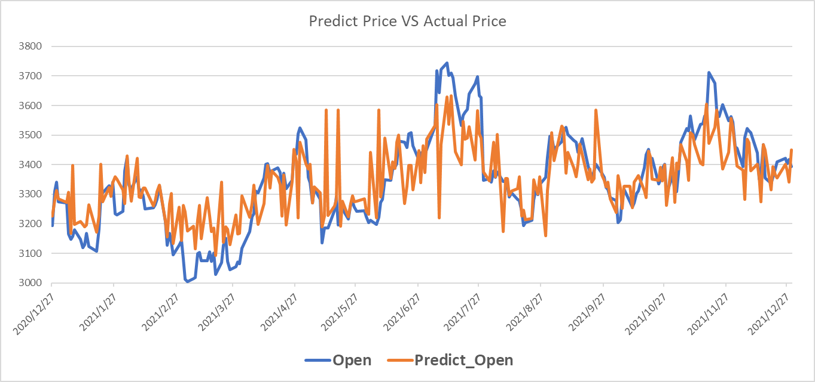
Result

